Slide 1


CS 147 AUT 2023
CheckUp
Medium-fi Prototype
Abbie, Delali, Susan, Angela

Slide 2
Roadmap
1
2
3
4
Problem Solution Overview
Value Prop
Values In Design
Tasks
5
6
7
8
Usability Goals
Revised Interface Sketches
Medium-Fi Task Flows
Prototype
Implementation
9
Link to Figma

Slide 3


CHECKUP
Care on your calendar.

Slide 4
Our Value Proposition
Problem
Solution
Too many students and working adults forgo seeking routine medical care because of friction in finding and scheduling that care.
CheckUp is a digital assistant that seamlessly syncs with your calendar and recommends care that fits right into your schedule.

Slide 5


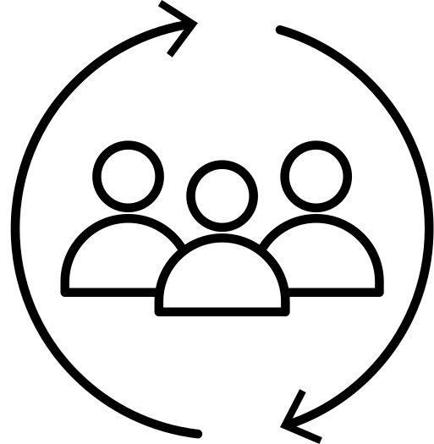

Values in Design
Values we want to encode in our project
Intuitive
Flexible
Inclusive
Privacy
Users should be able to easily understand how to book an appointment
Users should be able to customize their preferences for appointmet times and doctors
People of all demographics (age, gender, income, insured or not insured) should be able to use CheckUp
Users should be confident that their private health information is safe

Slide 6
Expression of Values
How our design values are reflected in our features
Intuitive
Flexible
Inclusive
Privacy
  Chat function to communicate with CheckUp
  Returns top 3 appointment times / doctors, easily clickable
  Allows user to input doctor preferences (location, gender, language, etc)
  Integrates with multiple types of digital calendars
  Allows for paper calendars to be scanned for older people
  Option for uninsured people to find cheapest doctor without insuracne
  All user information will be kept confidential
  Verification with FaceID every time you enter the app

Slide 7
Value Tensions
Inclusion vs Intuitive
Privacy vs Flexibility
While we want to have CheckUp cover multiple demographics, taking into account many cases might make the app unintuitive to use.
By having users enter their personal doctor preferences, insurance information, and past health information, users might not feel comfortable with their private information stored in our app.

Slide 8
Tasks
Simple
Moderate
Complex
CheckUp connects with the user’s calendar and doctor preferences to suggest them the best availabilities and provider
Users can view past and upcoming appointments and reschedule/cancel upcoming appointments
Users can communicate with CheckUp that they want to book an appointment

Slide 9
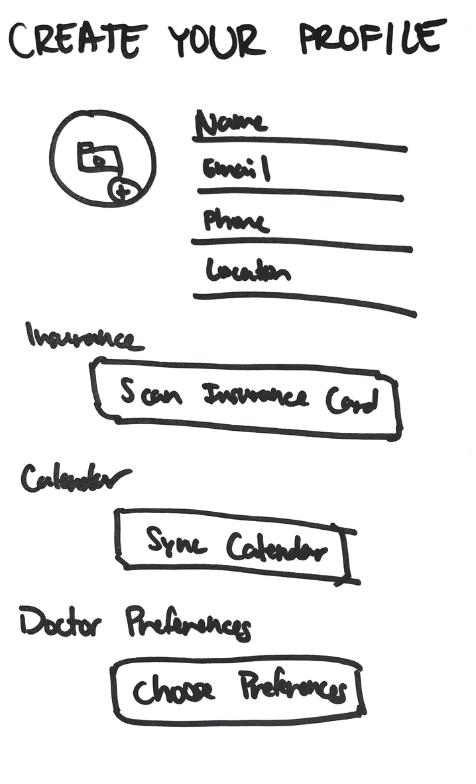
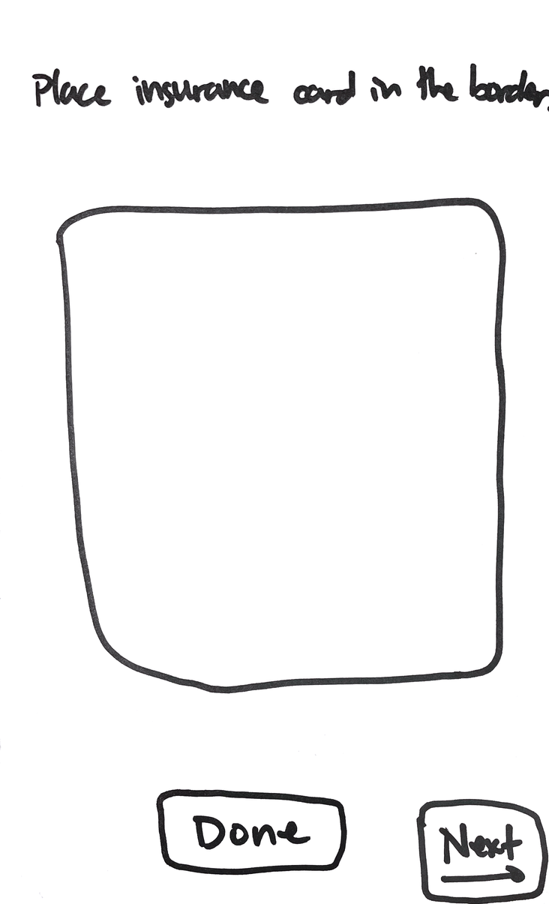
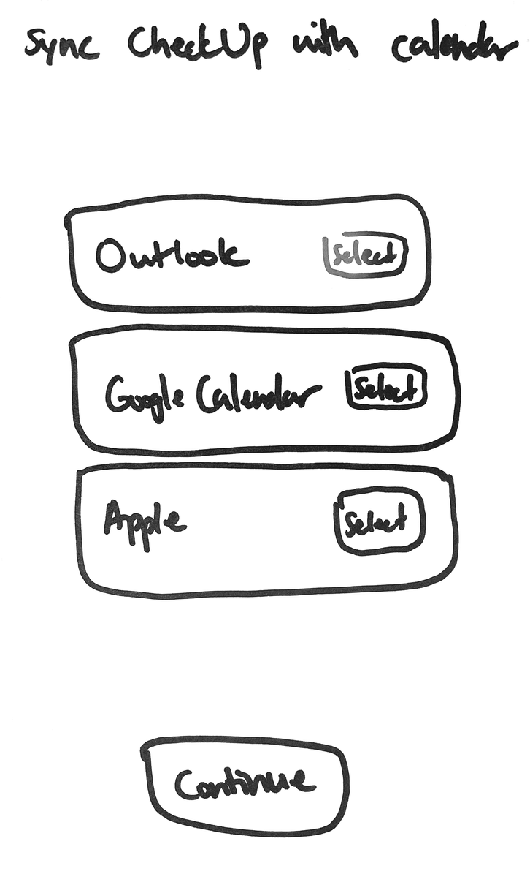
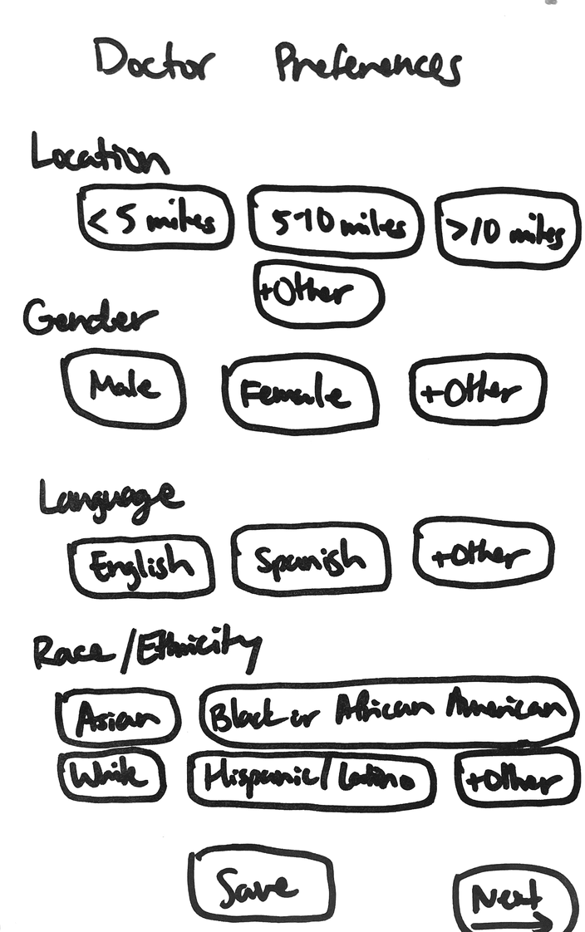
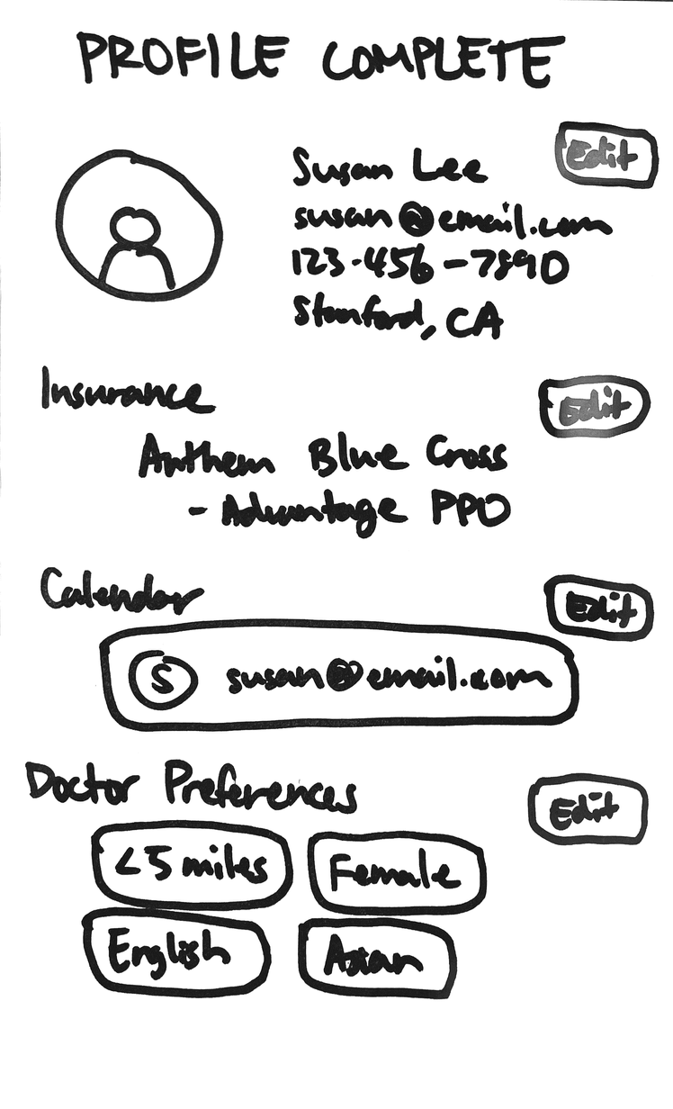
Design Change #1: Before

Slide 10
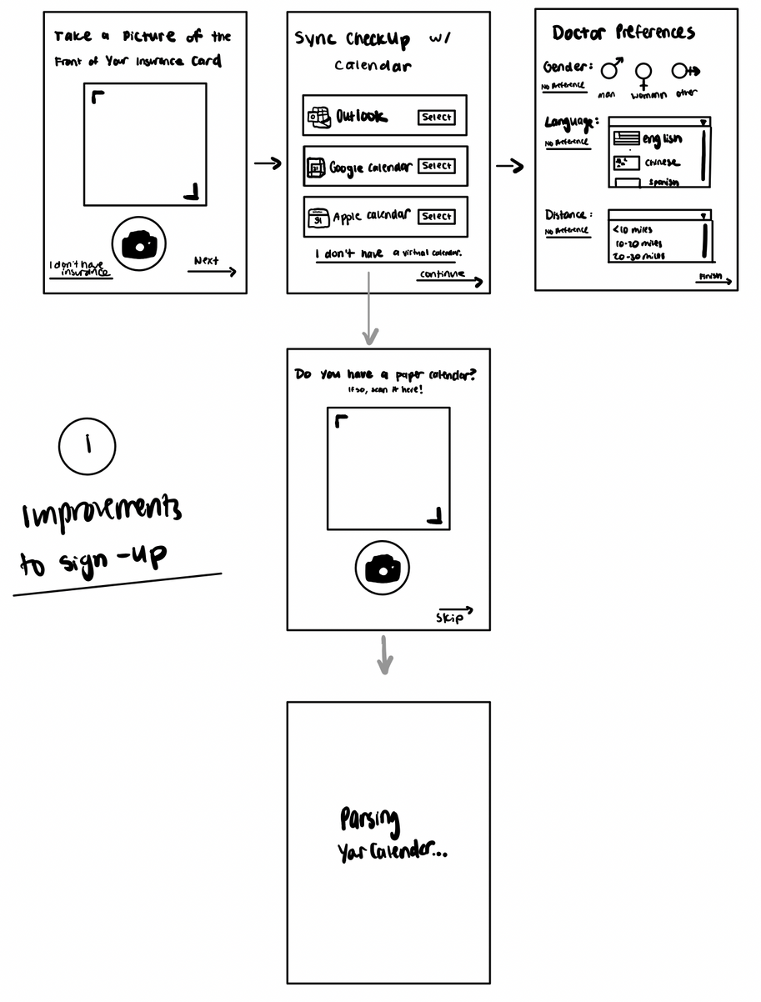
Design Change #1: After
  To maintain inclusivity, one of our core design values, we added a functionality that allows a user who does not use a digital calendar to scan a paper calendar in, which then gets parsed and then digitized.
  From our feedback, we simplified our doctor preferences to include gender and distance, but also introduced key factors like preferred language which is vital when seeking care

Slide 11
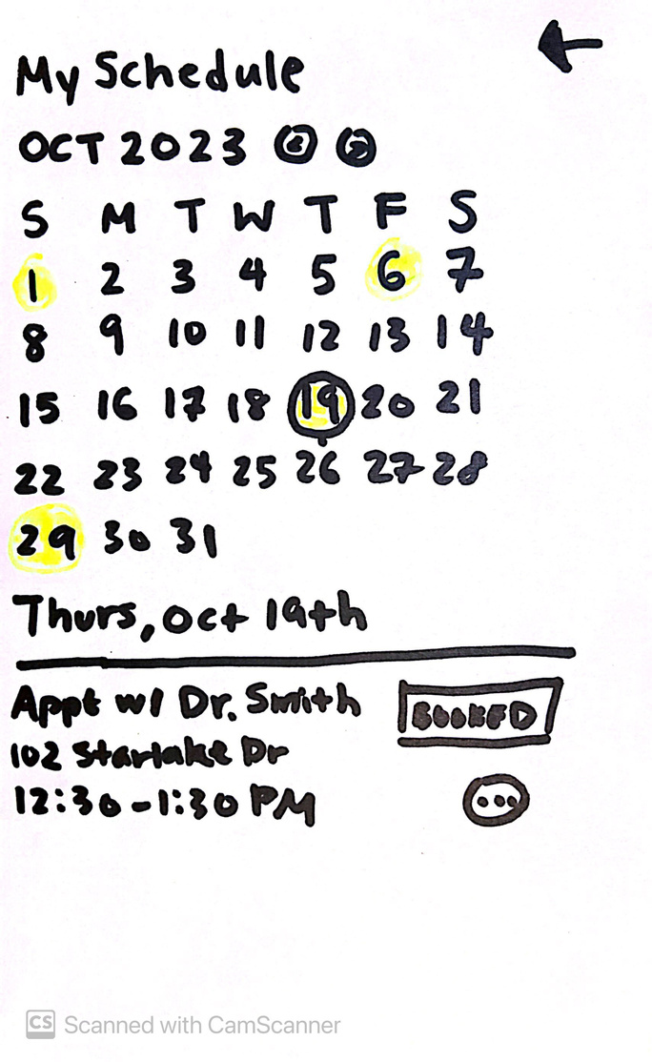
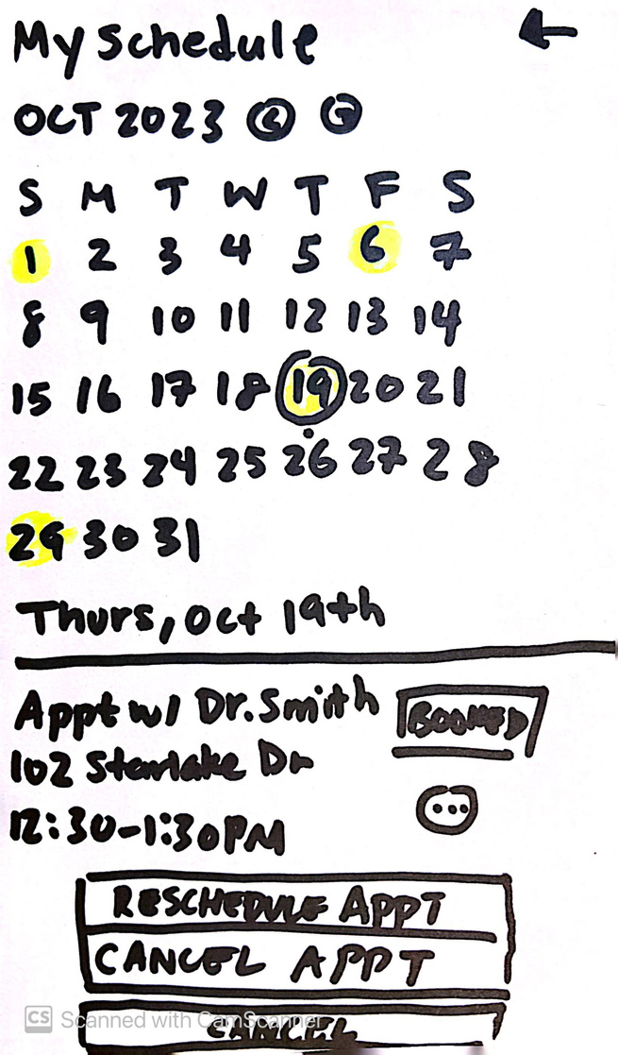
Design Change #2: Before

Slide 12
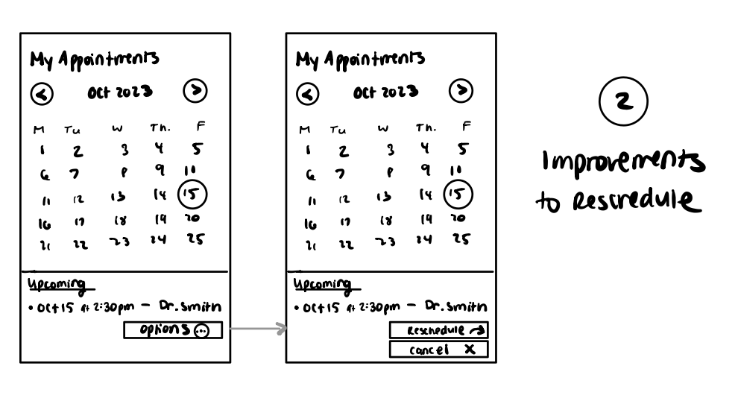
Design Change #2: After
  In our lo-fi protoype, if a user wanted to reschedule an appointment they had to click the three dots in the corner, which would then display more options
  In our prototype testing we found that this was not intuitive / apparent for most of our users
  We revised it, removing those three buttons and instead adding clear options that are embedded directly in the appointments interface

Slide 13
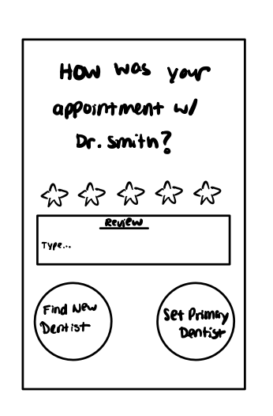
Design Change #3:
Completely New!
  We added a feature page in our appointment flow that allows the user to rate their experience with a medical practitioner.
  Ideally, this data will help our system and other users recommend the best care
  This feature also allows the user to set that doctor as their primary, which will further the ease of scheduling appointments, or find a new one

Slide 14
Usability Goals
& Measurements
1
2
Ease of Use
Intuitive Interface and Workflows
Measured by number of misclicks
Measured by number of questions asked

Slide 15
Progress
1
2
Intuitive Interface and Workflows
Ease of Use
To increase ease of use, we’ve made screens simpler and less cluttered, reduced the number of buttons on each page, and made buttons more descriptive in their function (e.g. “Options” instead of “...”)
To reduce confusion, we’ve made tasks like onboarding simpler (e.g. allowing users to skip steps, making the initial profile page have only one task to complete) and clarified how unique cases work (not having a digital calendar or insurance card)

Slide 16
Revised Interface Sketches
1
Skipping Onboarding Steps
Instead of displaying all the steps needed to onboard at once, we show only the first step and automatically have the flow go through the entire process, allowing users to skip steps if they wish to.
2
Editing Appointments
We revised the “View Appointments” page to be clearer, editing the “...” button into “Reschedule” and “Change,” clearly delineating the two options.
3
Viewing and Following Up Past Appointments
Users are able to view past appointments in addition to future appointments, and can flag past appointments for scheduling a follow-up.

Slide 17
Revisions Rationale
1
2
3
Skipping Onboarding Steps
Editing Appointments
Viewing and Following Up Past Appointments
  Users were confused by all the steps they had to complete to finish creating a profile and expressed a desire to skip some of the steps.
  To reduce confusion, we simplified the initial onboarding pages and created skippable, simpler steps
  Older users were confused how to reschedule an appointment at the view appointments page.
  To make the app more intuitive, we made the tasks easier to see, allowing older users to have the same experience as younger users.
  Viewing and following up on past appointments makes it easier to continuously schedule appointments and follow up on appointments.
  Users expressed wanting to see the appointments they had scheduled before, not just the future appointments.

Slide 18
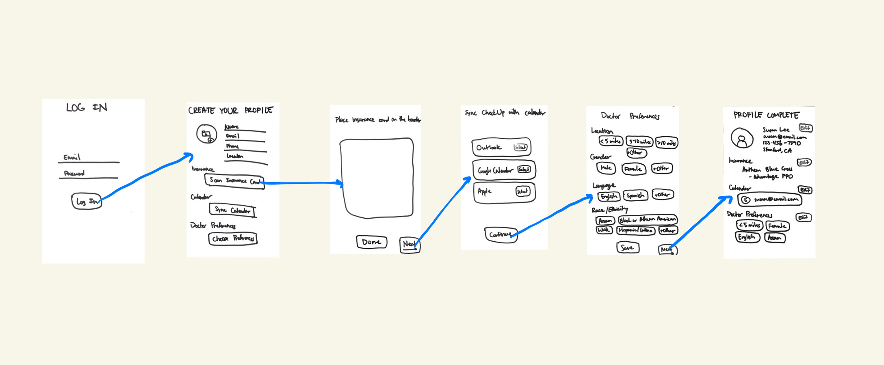
1
Skipping Onboarding Steps: Before

Slide 19
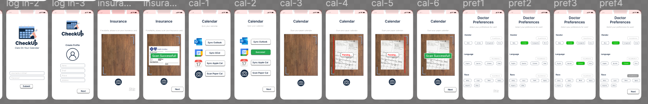
1
Skipping Onboarding Steps: After

Slide 20
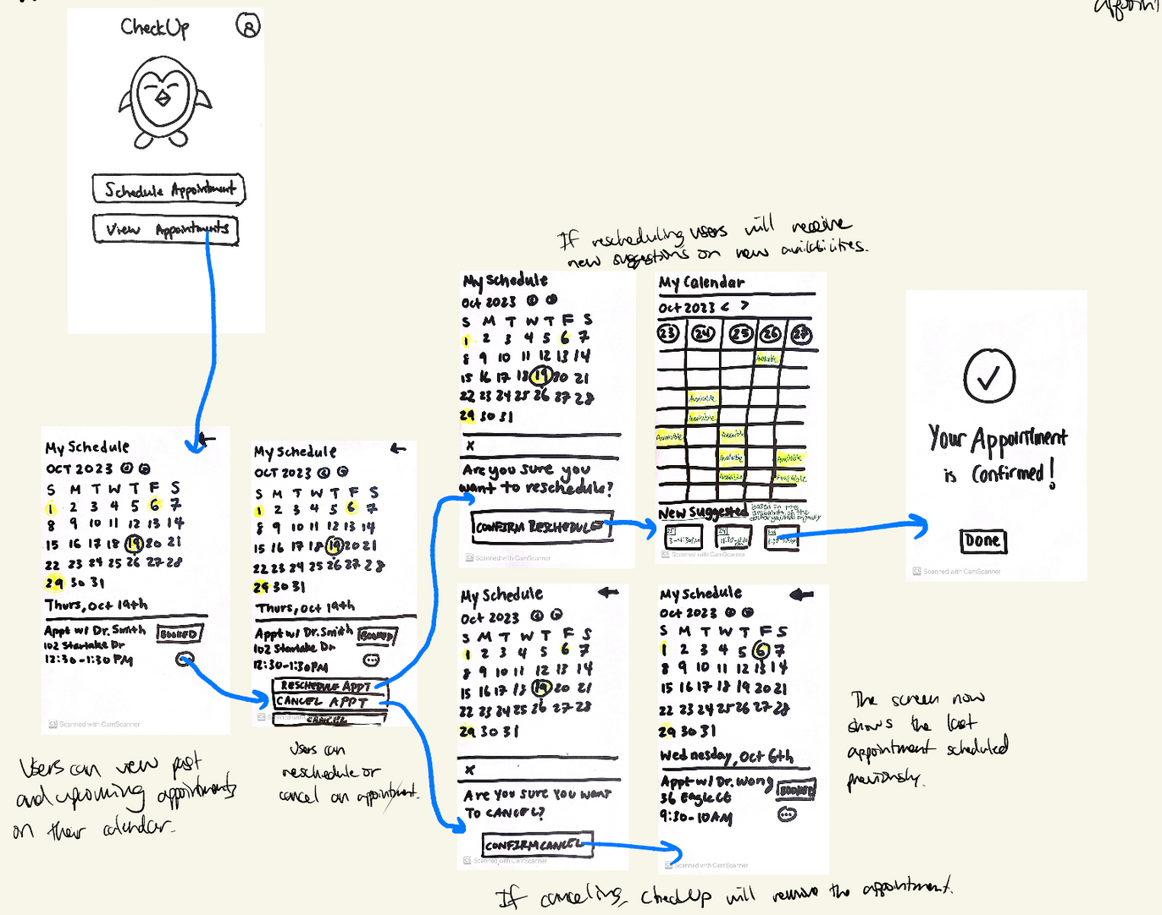
2
Editing Appointments: Before

Slide 21
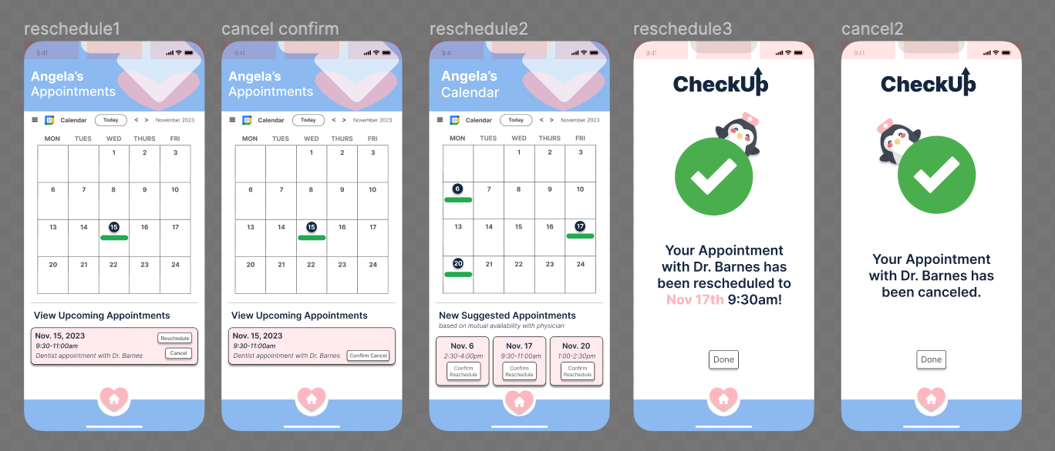
2
Editing Appointments: After

Slide 22
3
Viewing and Following Up Past Appointments: Before
Did Not Exist!

Slide 23
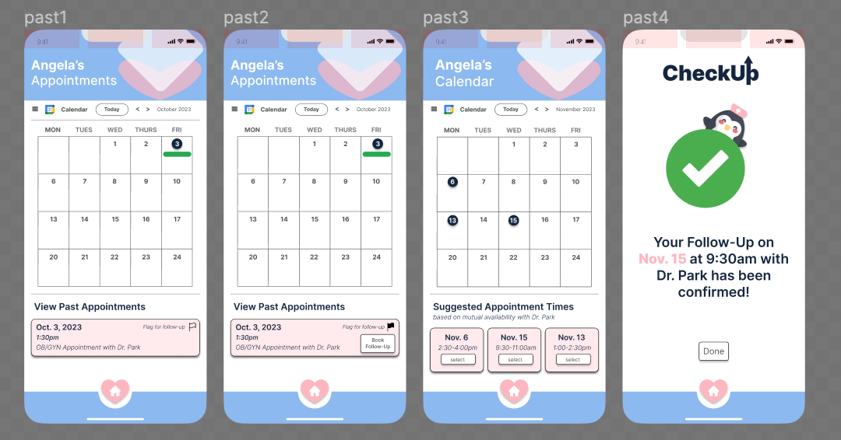
3
Viewing and Following Up Past Appointments: After

Slide 24
Med-Fi Task Flows

Slide 25
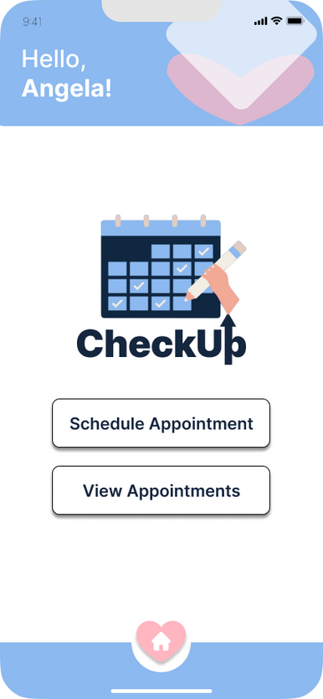
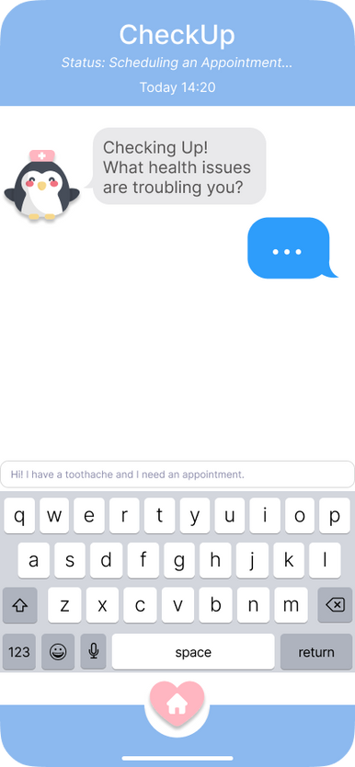
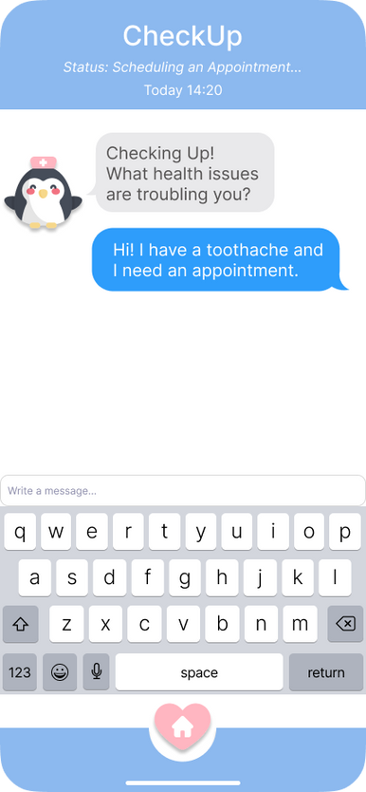
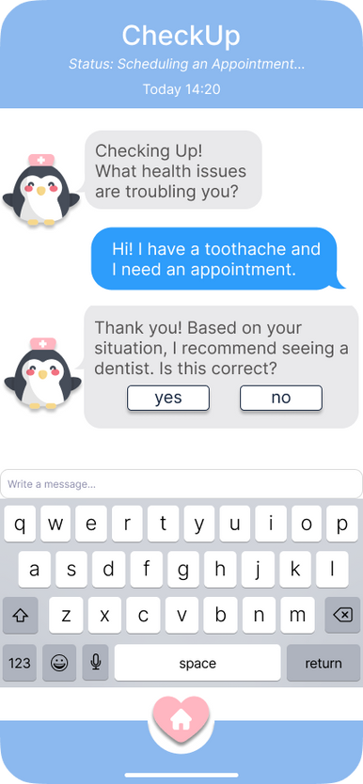
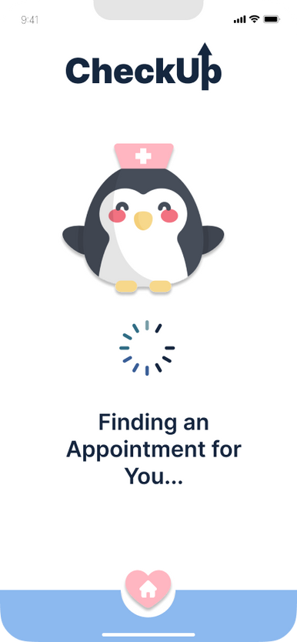
Users can communicate with CheckUp that they want to book an appointment
Simple
[Home Page of CheckUp, click Schedule Appointment]
[Chatting with CheckUp page, CheckUp initial prompt always the same]
[Type in your health issue, hard coded in example]
[CheckUp gives you a type of doctor advice, click yes to start the process of booking an appointment]
[Loading page, CheckUp is finding appointments and doctors for you]

Slide 26
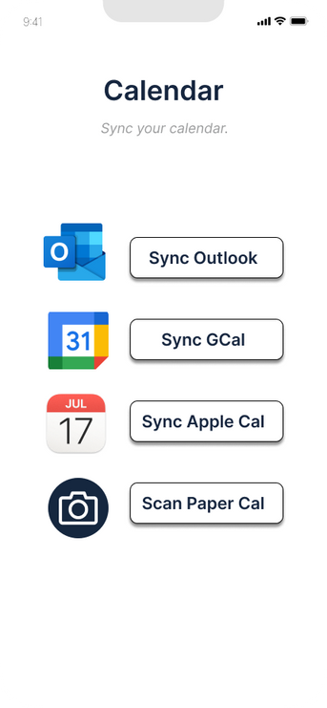
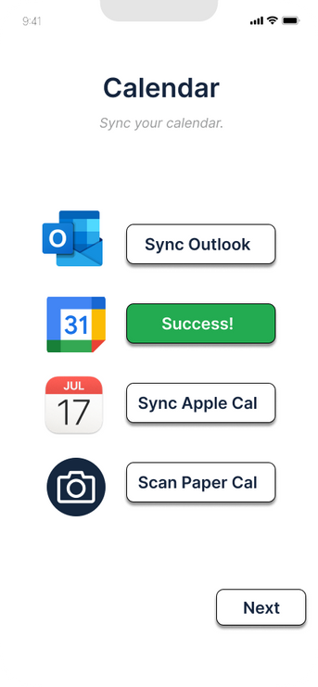
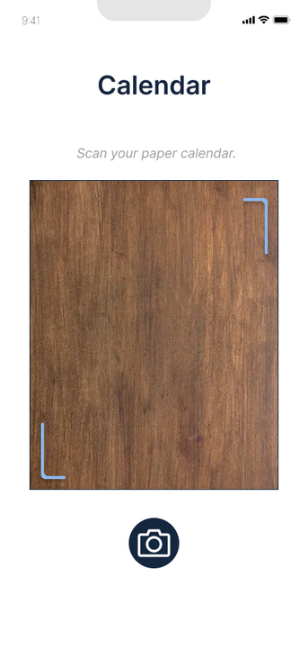
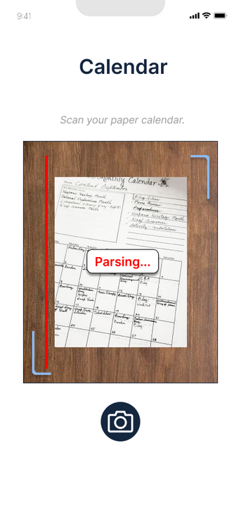
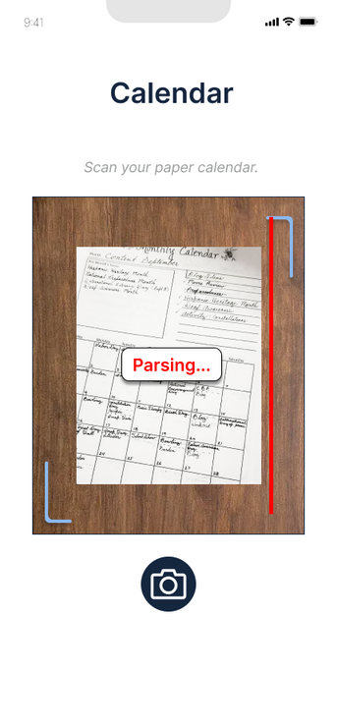
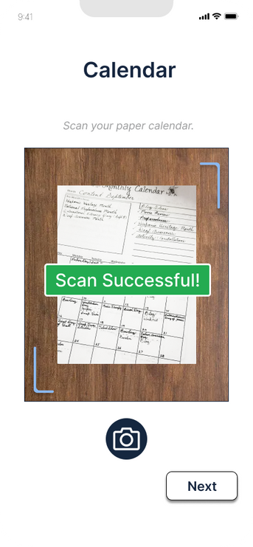
CheckUp connects with the user’s calendar and doctor preferences to suggest them the best availabilities and provider
Moderate
[Syncing calendar page, has 4 options to pick from, select Sync Gcal or Scan Paper Cal]
[Log into Google, will automatically Sync]
[Paper calendar scanner page, press camera button to take a picture of your paper calendar]
[Parsing paper calendar]
[Parsing paper calendar]
[Scan successful, press next to continue]

Slide 27
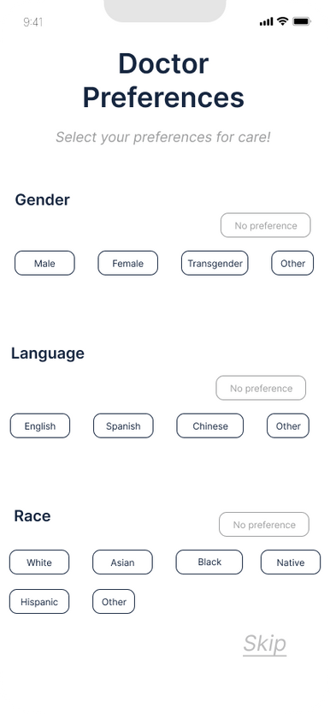
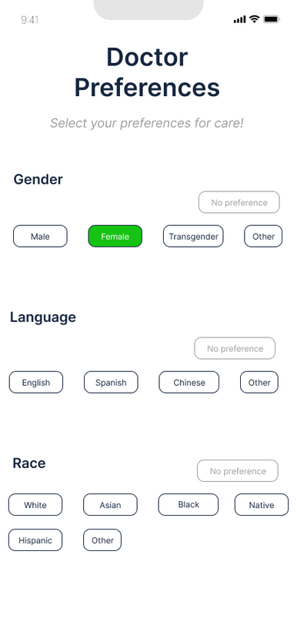
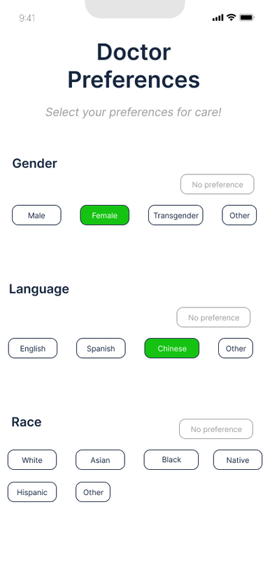
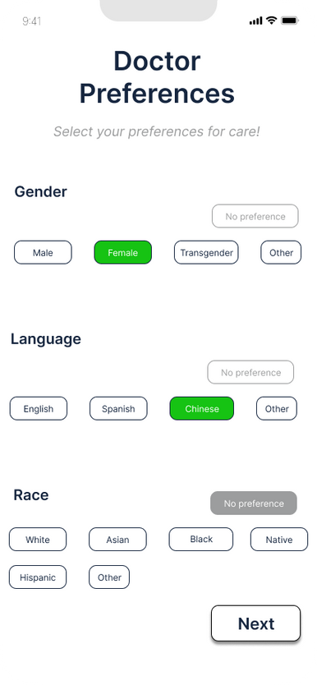
CheckUp connects with the user’s calendar and doctor preferences to suggest them the best availabilities and provider
Moderate
[Doctor preferences page, click buttons to make your selection, hard-coded to press Female]
[Hard-coded to select language as Chinese]
[Hard-coded to select Race as No Preference]
[After making your selections, press Next to continue]

Slide 28
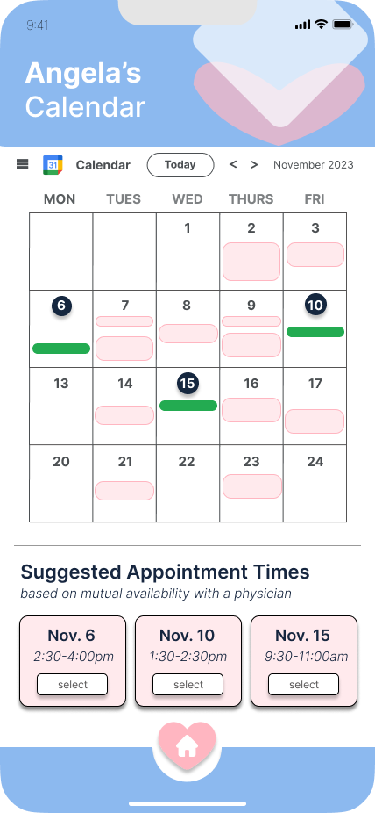
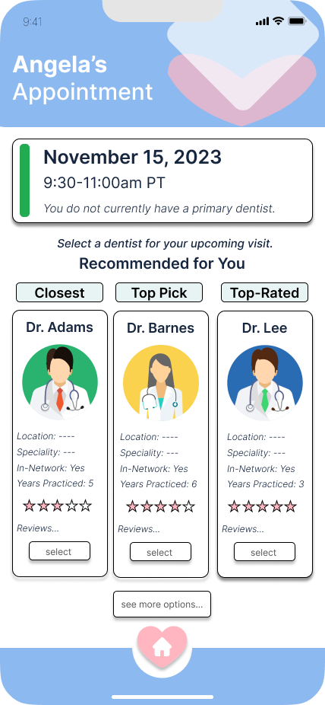
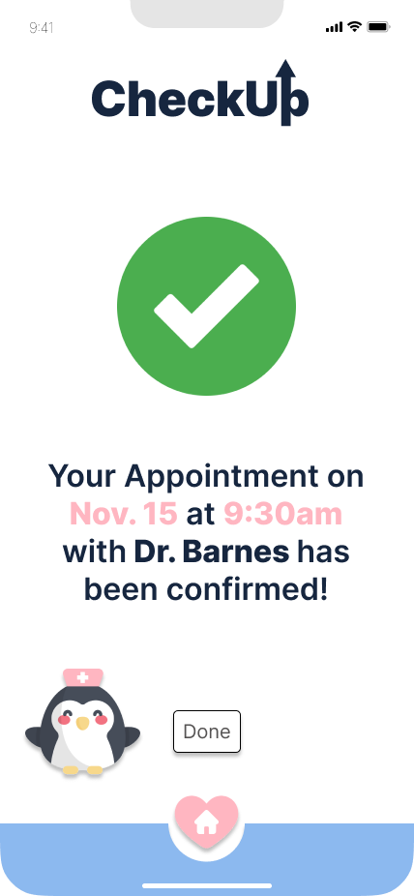
Moderate
CheckUp connects with the user’s calendar and doctor preferences to suggest them the best availabilities and provider
[Select appointment time page, GCal already synced and shown, press Nov 15th select]
[Select doctor page, shows 3 doctors based on category, select Dr. Barnes]
[Appointment Confirmation Page, press done]

Slide 29
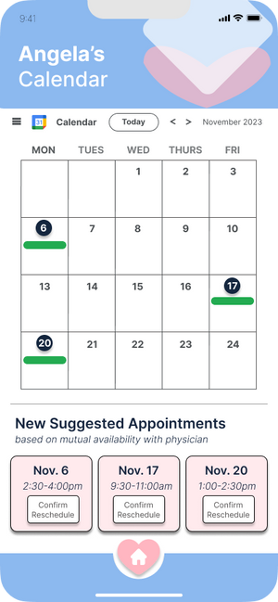
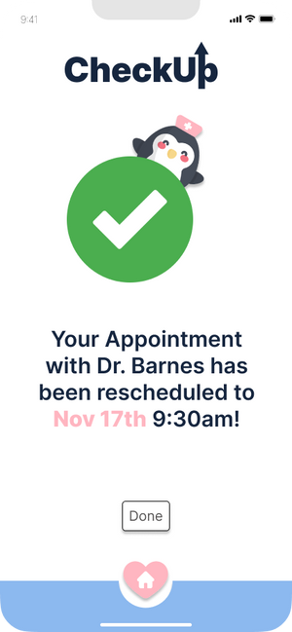
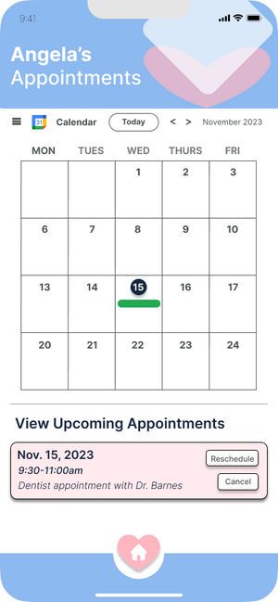
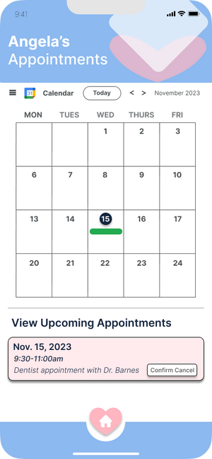
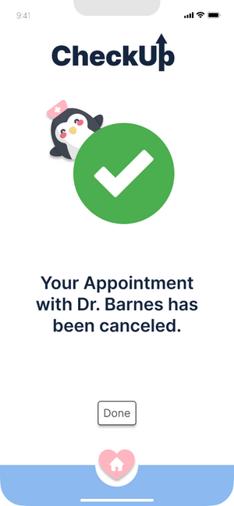
[Reschedule Page, click any option]
Complex
Users can view past and upcoming appointments and reschedule/cancel upcoming appointments
[View Appointments page, click Reschedule or Cancel]
[Cancel Appointment, click Confirm]

Slide 30
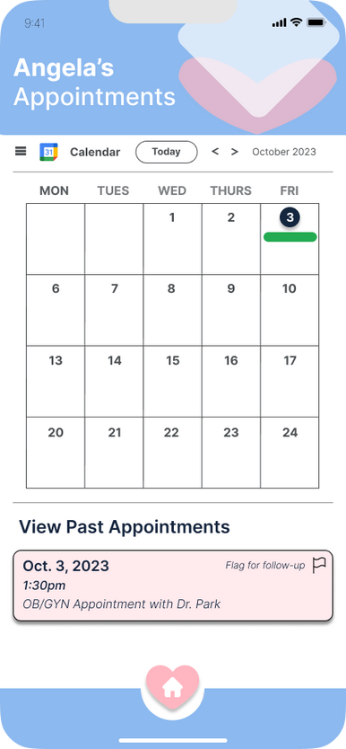
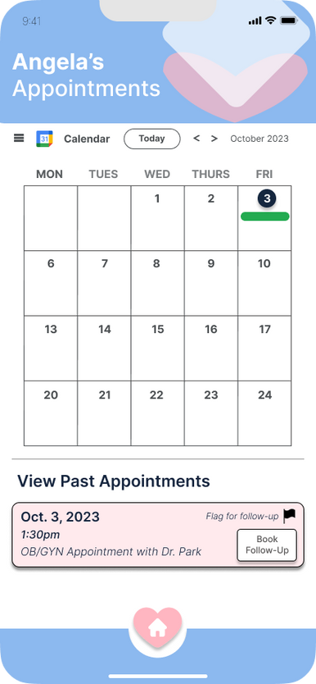
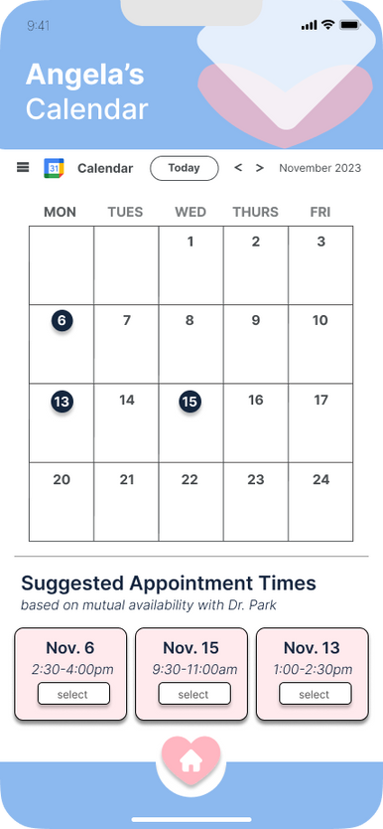
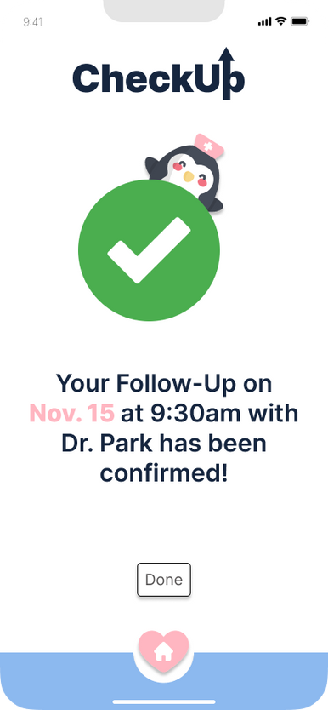
Complex
Users can view past and upcoming appointments and reschedule/cancel upcoming appointments
[View Appointments Page, currently at past month. Click Flag for follow-up]
[Book Follow-Up to schedule future appointment before forgetting!]
[User can select best appointment time]
[Follow-up appointment is confirmed]

Slide 31
Prototype Implementation
Tools
Canva
  Open-source images and icons.
  Pros: Easy-to-use, free, customizable
  Cons: Hard to integrate (had to convert to PNG, get rid of background, etc.)
Flaticon
  Open-source icons.
  Pros: Free, easy-to-use
  Cons: Hard to customize
iMessage Features
  Used to book appointments
  Pros: Almost universal understanding of chat interface based on user familiarity with iMessage
  Cons: Open-endedness could confuse users; potentially excludes users more familiar with Android
App Icons
  Outlook, Google Calendar, and Apple Calendar
  Pros: User understanding of icons based on familiarity
  Cons: Potential exclusion of non-digital calendar users

Slide 32
Prototype Implementation
Limitations
Users cannot truly customize preferences for sake of simplicity in minimizing screens.
Users cannot truly calibrate calendars and receive tailored appointment suggestions as it is a prototype.
Users aren’t able to actually receive notifications for follow-up appointments as it is a prototype.
Could not include all the preferences and customizations when creating a profile due to simplicity.
Users cannot edit their profile or appointments for simplicity sake.
Couldn’t actually recommend doctors based on preferences/location for simplicity and because it’s still a prototype.

Slide 33
Prototype Implementation
Hard-Coded Features
Instead of accessing user location, a real doctor database, and the inputted user’s health insurance information, we hard-coded these features. We also hard-coded the user’s responses in the chat interface for booking an appointment and the selection of the appointment and doctor in the booking/reschedule process for the sake of simplicity in our medium-fidelity prototype.

Slide 34
Prototype Implementation
Wizard-of-Oz Features
The Wizard-of-Oz technique is implemented in key areas of our med-fi prototype that are currently not possible to implement. This includes the chat responses to the user’s chats in the chat interface for booking an appointment and generating top choices for doctors based on preferences when booking an appointment. Since these are based on user input/preferences, which are currently hard-coded, we cannot generate these currently; in the future, we plan on utilizing Chat-GPT and an algorithm for choosing the best doctors for the chat and top doctors screens.

Slide 35
Thank you!
Figma Prototype

